Slide 1

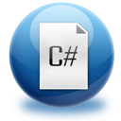


Introduction to Programming
Creating and Running Your First C# Program
C# Fundamentals – Part 1
Telerik Software Academy
http://academy.telerik.com

Slide 2


Table of Contents
What is Computer Programming?
Your First C# Program
What is .NET Framework?
What is Visual Studio?
What is MSDN Library?

Slide 3


What is Computer Programming?

Slide 4

Define: Computer Programming
Computer programming: creating a sequence of instructions to enable the computer to do something
Definition by Google

Slide 5
Programming Phases
Define a task/problem
Plan your solution
Find suitable algorithm to solve it
Find suitable data structures to use
Write code
Fix program error (bugs)
Make your customer happy
= Specification
= Design
= Implementation
= Testing & Debugging
= Deployment

Slide 6

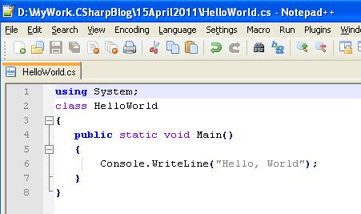
Your First C# Program

Slide 7
First Look at C#
Sample C# program:
using System;
class HelloCSharp
{
static void Main()
{
Console.WriteLine("Hello, C#");
}
}

Slide 8
C# Code – How It Works?
Define a class called "HelloCSharp"
Include the standard namespace "System"
Define the Main() method – the program entry point
using System;
class HelloCSharp
{
static void Main()
{
Console.WriteLine("Hello, C#");
}
}
Print a text on the console by calling the method "WriteLine" of the class "Console"

Slide 9
C# Code Should Be Well Formatted
Class names should use PascalCase and start with a CAPITAL letter.
using System;
class HelloCSharp
{
static void Main()
{
Console.WriteLine("Hello, C#");
}
}
The { symbol should be alone on a new line.
The } symbol should be under the corresponding {.
The block after the { symbol should be indented by a TAB.

Slide 10
Example of Bad Formatting
Such formatting makes the source code unreadable.
using
System
;
class HelloCSharp {
static
void Main( ) { Console . WriteLine ("Hello, C#" ) ;Console.
WriteLine ( "Hello again"
) ;}}

Slide 11

What is "C#"?
Programming language
A syntax that allow to give instructions to the computer
C# features:
New cutting edge language
Extremely powerful
Easy to learn
Easy to read and understand
Object-oriented

Slide 12

What You Need to Program?
Knowledge of a programming language
C#
Task to solve
Development environment, compilers, SDK
Visual Studio, .NET Framework SDK
Set of useful standard classes
Microsoft .NET Framework FCL
Help documentation
MSDN Library

Slide 13

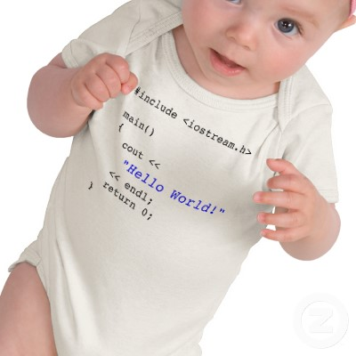
Your First C# Program
Live Demo

Slide 14

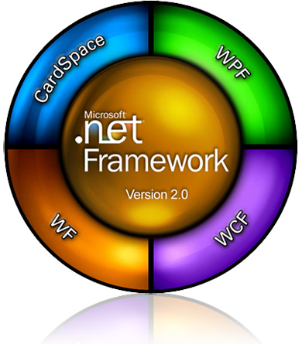

What is .NET Framework?

Slide 15

What is .NET Framework?
Environment for execution of .NET programs
Powerful library of classes
Programming model
Common execution engine for many programming languages
C#
Visual Basic .NET
Managed C++
... and many others

Slide 16
Inside .NET Framework
Building blocks of .NET Framework
C#
C++
VB.NET
J#
F#
PHP
Perl
Delphi
…
ASP.NET
Web Forms, MVC, Web API, SignalR
Windows
Forms
WPF / XAML
WinJS / Win8
FCL
WCF and WWF (Communication and Workflow Tier)
ADO.NET, EF, LINQ and XML (Data Tier)
Base Class Library (BCL)
CLR
Common Language Runtime (CLR)
Operating System (OS)

Slide 17
CLR – The Heart of .NET Framework
Common Language Runtime (CLR)
Managed execution environment
Executes .NET applications
Controls the execution process
Automatic memory management (garbage collection)
Programming languages integration
Multiple versions support for assemblies
Integrated type safety and security
CLR

Slide 18
Framework Class Library
Framework Class Library (FCL)
Provides basic functionality to developers:
Console applications
WPF and Silverlight rich-media applications
Windows Forms GUI applications
Web applications (dynamic Web sites)
Web services, communication and workflow
Server & desktop applications
Applications for mobile devices

Slide 19

What is Visual Studio?
Compiling, Running and Debugging C# Programs

Slide 20

Visual Studio
Visual Studio – Integrated Development Environment (IDE)
Development tool that helps us to:
Write code
Design user interface
Compile code
Execute / test / debug applications
Browse the help
Manage project's files

Slide 21
Benefits of Visual Studio
Single tool for:
Writing code in many languages (C#, VB, …)
Using different technologies (Web, WPF, …)
For different platforms (.NET CF, Silverlight, …)
Full integration of most development activities (coding, compiling, testing, debugging, deployment, version control, ...)
Very easy to use!

Slide 22
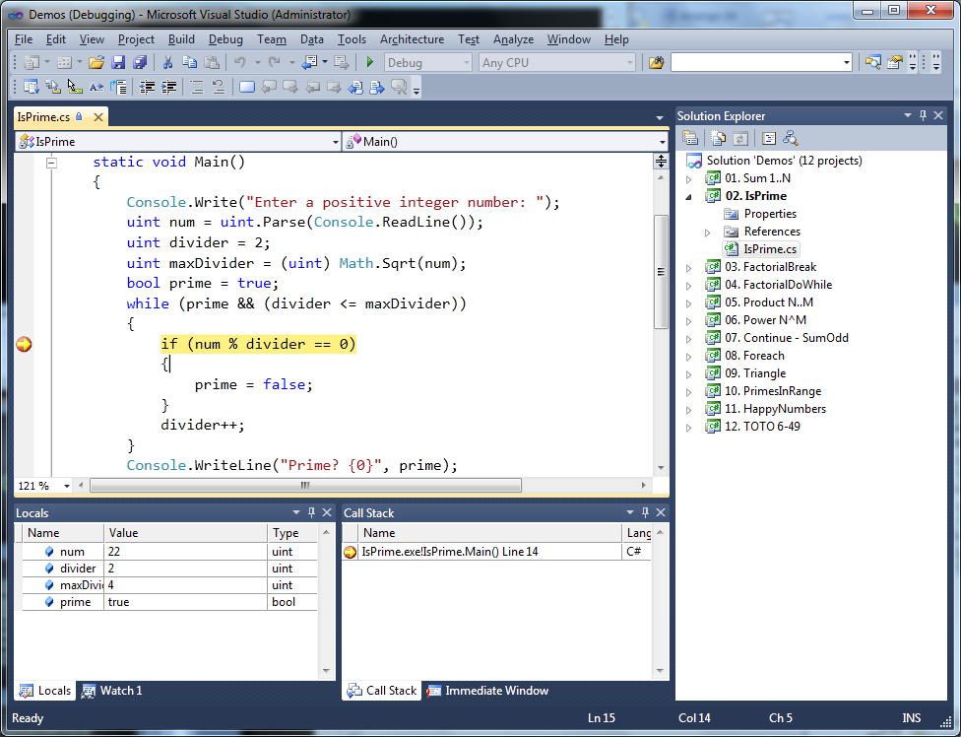
Visual Studio – Example

Slide 23
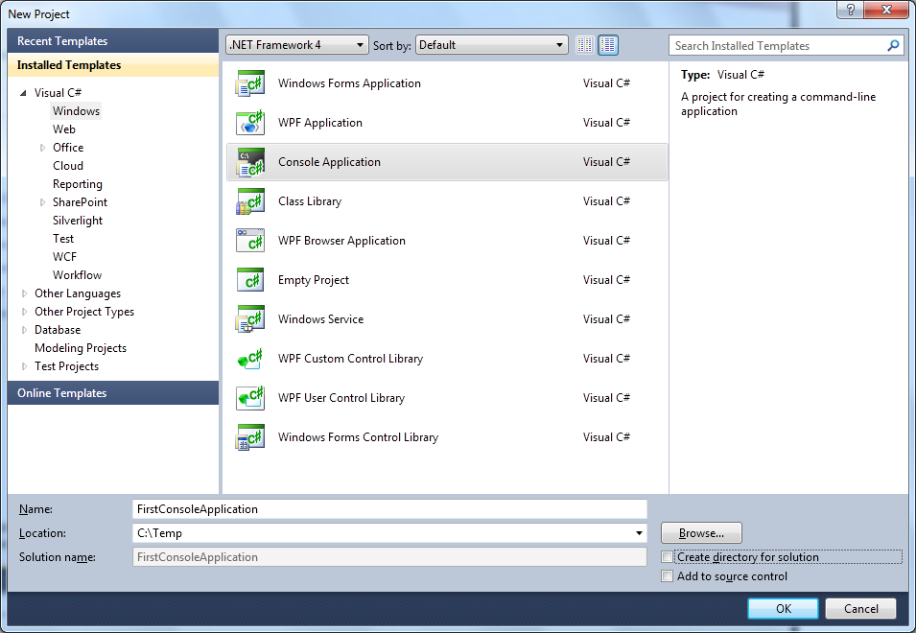
Creating New Console Application
File → New → Project ...
Choose C# console application
Choose project directory and name

Slide 24
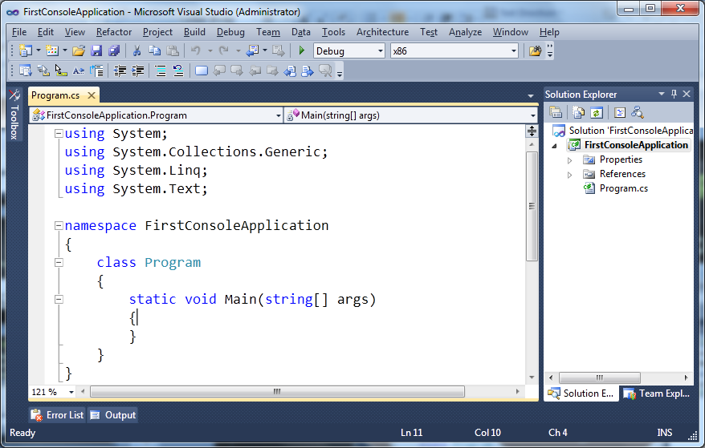
Creating New Console Application (2)
Visual Studio creates some source code for you
Namespace not required
Some imports are not required
Class name should be changed

Slide 25
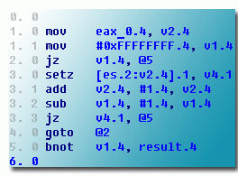
Compiling Source Code
The process of compiling includes:
Syntactic checks
Type safety checks
Translation of the source code to lower level language (MSIL)
Creating of executable files (assemblies)
You can start compilation by
Using Build->Build Solution/Project
Pressing [F6] or [Shift+Ctrl+B]

Slide 26

Running Programs
The process of running application includes:
Compiling (if project not compiled)
Starting the application
You can run application by:
Using Debug->Start menu
By pressing [F5] or [Ctrl+F5]
* NOTE: Not all types of projects are able to be started!

Slide 27



Debugging The Code
The process of debugging application includes:
Spotting an error
Finding the lines of code that cause the error
Fixing the code
Testing to check if the error is gone and no errors are introduced
Iterative and continuous process

Slide 28
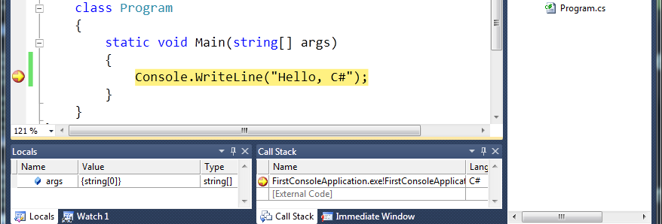
Debugging in Visual Studio
Visual Studio has built-in debugger
It provides:
Breakpoints
Ability to trace the code execution
Ability to inspect variables at runtime

Slide 29

Visual Studio
Compiling, Running and Debugging C# Programs
Live Demo

Slide 30
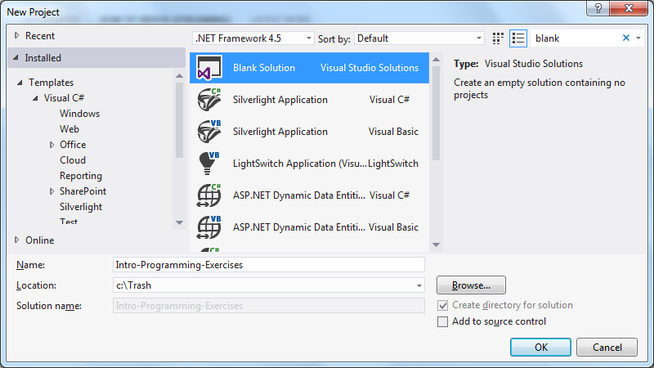

Visual Studio Blank Solution
Creating a Solution Without Projects

Slide 31
What Is a Blank Solution?
A Visual Studio blank solution
Solution with no projects in it
Projects to be added later
What is the point?
Not making a project just to give proper name
And not working in this project

Slide 32
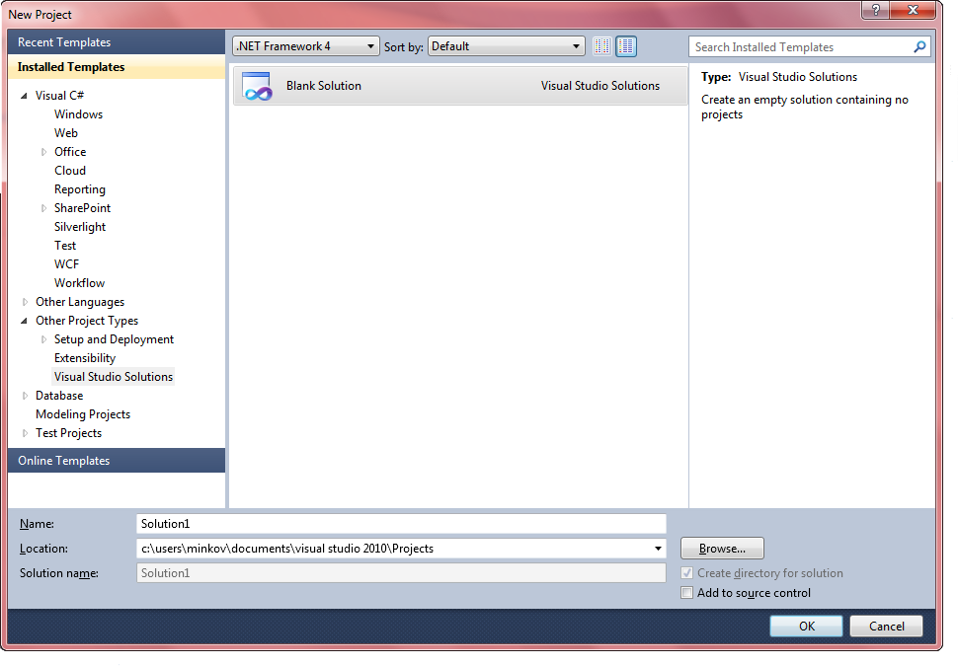
VS Blank Solution

Slide 33

Visual Studio Blank Solution
Live Demo

Slide 34



What is MSDN Library?

Slide 35

What is MSDN Library?
Complete documentation of all classes and their functionality
With descriptions of all methods, properties, events, etc.
With code examples
Related articles
Library of samples
Use local copy or the Web version at http://msdn.microsoft.com/

Slide 36
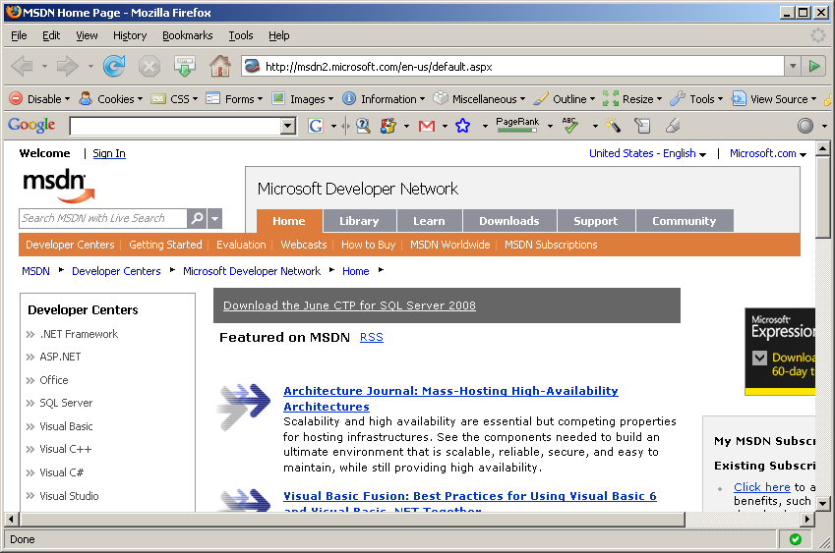
MSDN Library

Slide 37
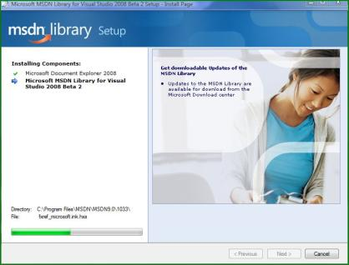
How to Use MSDN Library?
Offline version (obsolete)
Use the table of contents
Use the alphabetical index
Search for phrase or keyword
Filter by technology
Browse your favorite articles
Online version
Use the built-in search: [F1]

Slide 38


MSDN Library
Browsing and Searching Documentation
Live Demo

Slide 39



Introduction to Programming
Questions?
http://academy.telerik.com

Slide 40


Free Trainings @ Telerik Academy
Fundamentals of C# Programming Track of Courses
csharpfundamentals.telerik.com
Telerik Software Academy
academy.telerik.com
Telerik Academy @ Facebook
facebook.com/TelerikAcademy
Telerik Academy Learning System
telerikacademy.com

Slide 41

Primitive Data Types and Variables
Integer, Floating-Point, Text Data, Variables, Literals
C# Fundamentals – Part 1
Telerik Software Academy
http://academy.telerik.com

Slide 42

Table of Contents
Primitive Data Types
Integer
Floating-Point / Decimal Floating-Point
Boolean
Character
String
Object
Declaring and Using Variables
Identifiers
Declaring Variables and Assigning Values
Literals
Nullable Types

Slide 43


Primitive Data Types

Slide 44
How Computing Works?
Computers are machines that process data
Data is stored in the computer memory in variables
Variables have name, data type and value
Example of variable definition and assignment in C#
Variable name
Data type
int count = 5;
Variable value

Slide 45

What Is a Data Type?
A data type:
Is a domain of values of similar characteristics
Defines the type of information stored in the computer memory (in a variable)
Examples:
Positive integers: 1, 2, 3, …
Alphabetical characters: a, b, c, …
Days of week: Monday, Tuesday, …

Slide 46

Data Type Characteristics
A data type has:
Name (C# keyword or .NET type)
Size (how much memory is used)
Default value
Example:
Integer numbers in C#
Name: int
Size: 32 bits (4 bytes)
Default value: 0

Slide 47

Integer Types

Slide 48

What are Integer Types?
Integer types:
Represent whole numbers
May be signed or unsigned
Have range of values, depending on the size of memory used
The default value of integer types is:
0 – for integer types, except
0L – for the long type

Slide 49
Integer Types
Integer types are:
sbyte (-128 to 127): signed 8-bit
byte (0 to 255): unsigned 8-bit
short (-32,768 to 32,767): signed 16-bit
ushort (0 to 65,535): unsigned 16-bit
int (-2,147,483,648 to 2,147,483,647): signed 32-bit
uint (0 to 4,294,967,295): unsigned 32-bit

Slide 50

Integer Types (2)
More integer types:
long (-9,223,372,036,854,775,808 to 9,223,372,036,854,775,807): signed 64-bit
ulong (0 to 18,446,744,073,709,551,615): unsigned 64-bit

Slide 51
Measuring Time – Example
Depending on the unit of measure we may use different data types:
byte centuries = 20; // Usually a small number
ushort years = 2000;
uint days = 730480;
ulong hours = 17531520; // May be a very big number
Console.WriteLine("{0} centuries is {1} years, or {2} days, or {3} hours.", centuries, years, days, hours);

Slide 52

Integer Types
Live Demo

Slide 53

Floating-Point and Decimal Floating-Point Types

Slide 54

What are Floating-Point Types?
Floating-point types:
Represent real numbers
May be signed or unsigned
Have range of values and different precision depending on the size of memory used
Can behave abnormally in the calculations

Slide 55
Floating-Point Types
Floating-point types are:
float (±1.5 × 10⁻⁴⁵ to ±3.4 × 10³⁸): 32-bits, precision of 7 digits
double (±5.0 × 10⁻³²⁴ to ±1.7 × 10³⁰⁸): 64-bits, precision of 15-16 digits
The default value of floating-point types:
Is 0.0F for the float type
Is 0.0D for the double type

Slide 56
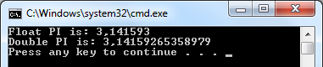
PI Precision – Example
See below the difference in precision when using float and double:
NOTE: The “f” suffix in the first statement!
Real numbers are by default interpreted as double!
One should explicitly convert them to float
float floatPI = 3.141592653589793238f;
double doublePI = 3.141592653589793238;
Console.WriteLine("Float PI is: {0}", floatPI);
Console.WriteLine("Double PI is: {0}", doublePI);

Slide 57

Abnormalities in the Floating-Point Calculations
Sometimes abnormalities can be observed when using floating-point numbers
Comparing floating-point numbers can not be performed directly with the == operator
Example:
double a = 1.0f;
double b = 0.33f;
double sum = 1.33f;
bool equal = (a+b == sum); // False!!!
Console.WriteLine("a+b={0} sum={1} equal={2}",
a+b, sum, equal);

Slide 58

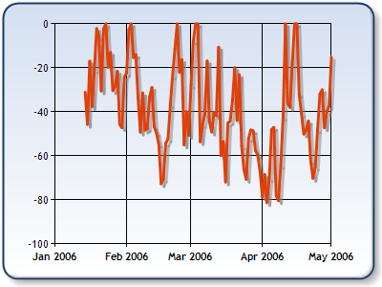
Decimal Floating-Point Types
There is a special decimal floating-point real number type in C#:
decimal (±1,0 × 10⁻²⁸ to ±7,9 × 10²⁸): 128-bits, precision of 28-29 digits
Used for financial calculations
No round-off errors
Almost no loss of precision
The default value of decimal type is:
0.0M (M is the suffix for decimal numbers)

Slide 59

Floating-Point and Decimal Floating-Point Types
Live Demo

Slide 60


Boolean Type

Slide 61

The Boolean Data Type
The Boolean data type:
Is declared by the bool keyword
Has two possible values: true and false
Is useful in logical expressions
The default value is false

Slide 62
Boolean Values – Example
Example of boolean variables taking values of true or false:
int a = 1;
int b = 2;
bool greaterAB = (a > b);
Console.WriteLine(greaterAB); // False
bool equalA1 = (a == 1);
Console.WriteLine(equalA1); // True

Slide 63

Boolean Type
Live Demo

Slide 64


Character Type

Slide 65
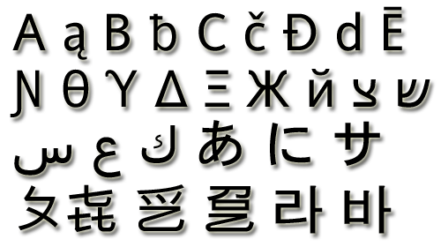
The Character Data Type
The character data type:
Represents symbolic information
Is declared by the char keyword
Gives each symbol a corresponding integer code
Has a '\0' default value
Takes 16 bits of memory (from U+0000 to U+FFFF)

Slide 66
Characters and Codes
The example below shows that every symbol has an unique Unicode code:
char symbol = 'a';
Console.WriteLine("The code of '{0}' is: {1}",
symbol, (int) symbol);
symbol = 'b';
Console.WriteLine("The code of '{0}' is: {1}",
symbol, (int) symbol);
symbol = 'A';
Console.WriteLine("The code of '{0}' is: {1}",
symbol, (int) symbol);

Slide 67

Character Type
Live Demo

Slide 68

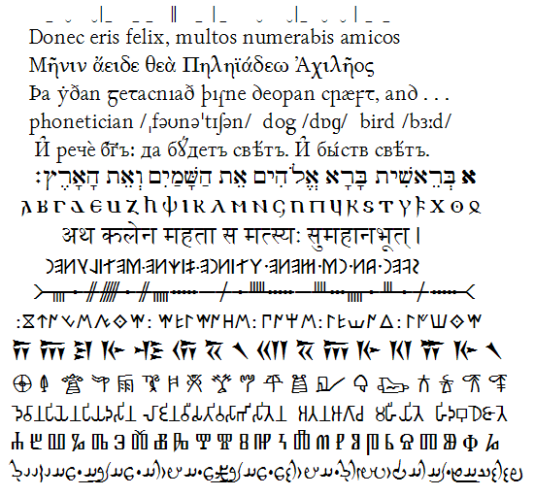
String Type

Slide 69
The String Data Type
The string data type:
Represents a sequence of characters
Is declared by the string keyword
Has a default value null (no value)
Strings are enclosed in quotes:
Strings can be concatenated
Using the + operator
string s = "Microsoft .NET Framework";

Slide 70
Saying Hello – Example
Concatenating the two names of a person to obtain his full name:
NOTE: a space is missing between the two names! We have to add it manually
string firstName = "Ivan";
string lastName = "Ivanov";
Console.WriteLine("Hello, {0}!\n", firstName);
string fullName = firstName + " " + lastName;
Console.WriteLine("Your full name is {0}.",
fullName);

Slide 71

String Type
Live Demo

Slide 72

Object Type

Slide 73


The Object Type
The object type:
Is declared by the object keyword
Is the base type of all other types
Can hold values of any type

Slide 74
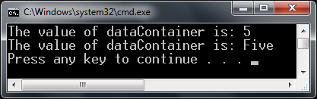
Using Objects
Example of an object variable taking different types of data:
object dataContainer = 5;
Console.Write("The value of dataContainer is: ");
Console.WriteLine(dataContainer);
dataContainer = "Five";
Console.Write("The value of dataContainer is: ");
Console.WriteLine(dataContainer);

Slide 75

Objects
Live Demo

Slide 76


Introducing Variables
p
q
i

Slide 77

What Is a Variable?
A variable is a:
Placeholder of information that can usually be changed at run-time
Variables allow you to:
Store information
Retrieve the stored information
Manipulate the stored information

Slide 78

Variable Characteristics
A variable has:
Name
Type (of stored data)
Value
Example:
Name: counter
Type: int
Value: 5
int counter = 5;

Slide 79
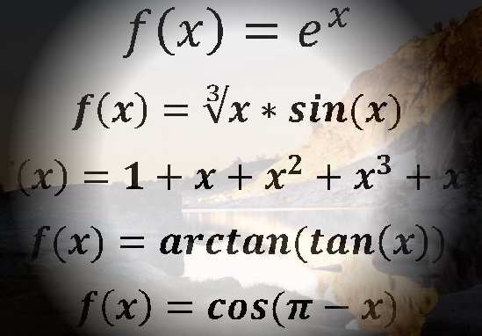
Declaring And Using Variables

Slide 80
Declaring Variables
When declaring a variable we:
Specify its type
Specify its name (called identifier)
May give it an initial value
The syntax is the following:
Example:
<data_type> <identifier> [= <initialization>];
int height = 200;

Slide 81

Identifiers
Identifiers may consist of:
Letters (Unicode)
Digits [0-9]
Underscore "_"
Identifiers
Can begin only with a letter or an underscore
Cannot be a C# keyword

Slide 82
Identifiers (2)
Identifiers
Should have a descriptive name
It is recommended to use only Latin letters
Should be neither too long nor too short
Note:
In C# small letters are considered different than the capital letters (case sensitivity)

Slide 83
Identifiers – Examples
Examples of correct identifiers:
Examples of incorrect identifiers:
int New = 2; // Here N is capital
int _2Pac; // This identifiers begins with _
string поздрав = "Hello"; // Unicode symbols used
// The following is more appropriate:
string greeting = "Hello";
int n = 100; // Undescriptive
int numberOfClients = 100; // Descriptive
// Overdescriptive identifier:
int numberOfPrivateClientOfTheFirm = 100;
int new; // new is a keyword
int 2Pac; // Cannot begin with a digit

Slide 84


Assigning Values To Variables

Slide 85

Assigning Values
Assigning of values to variables
Is achieved by the = operator
The = operator has
Variable identifier on the left
Value of the corresponding data type on the right
Could be used in a cascade calling, where assigning is done from right to left

Slide 86

Assigning Values – Examples
Assigning values example:
int firstValue = 3;
int secondValue;
int thirdValue;
// Using an already declared variable:
secondValue = firstValue;
// The following cascade calling assigns
// 3 to firstValue and then firstValue
// to thirdValue, so both variables have
// the value 3 as a result:
thirdValue = firstValue = 3; // Avoid this!

Slide 87
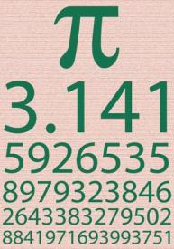
Initializing Variables
Initializing
Is assigning of initial value
Must be done before the variable is used!
Several ways of initializing:
By using the new keyword
By using a literal expression
By referring to an already initialized variable

Slide 88
Initialization – Examples
Example of some initializations:
// The following would assign the default
// value of the int type to num:
int num = new int(); // num = 0
// This is how we use a literal expression:
float heightInMeters = 1.74f;
// Here we use an already initialized variable:
string greeting = "Hello World!";
string message = greeting;

Slide 89
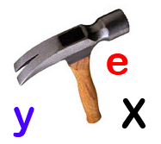

Assigning and Initializing Variables
Live Demo

Slide 90

Literals

Slide 91

What are Literals?
Literals are:
Representations of values in the source code
There are six types of literals
Boolean
Integer
Real
Character
String
The null literal

Slide 92
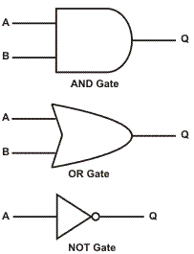
Boolean and Integer Literals
The boolean literals are:
true
false
The integer literals:
Are used for variables of type int, uint, long, and ulong
Consist of digits
May have a sign (+,-)
May be in a hexadecimal format

Slide 93
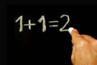
Integer Literals
Examples of integer literals
The '0x' and '0X' prefixes mean a hexadecimal value, e.g. 0xA8F1
The 'u' and 'U' suffixes mean a ulong or uint type, e.g. 12345678U
The 'l' and 'L' suffixes mean a long or ulong type, e.g. 9876543L

Slide 94
Integer Literals – Example
// The following variables are
// initialized with the same value:
int numberInHex = -0x10;
int numberInDec = -16;
// The following causes an error,
because 234u is of type uint
int unsignedInt = 234u;
// The following causes an error,
because 234L is of type long
int longInt = 234L;
Note: the letter ‘l’ is easily confused with the digit ‘1’ so it’s better to use ‘L’!!!

Slide 95
Real Literals
The real literals:
Are used for values of type float, double and decimal
May consist of digits, a sign and “.”
May be in exponential notation: 6.02e+23
The “f” and “F” suffixes mean float
The “d” and “D” suffixes mean double
The “m” and “M” suffixes mean decimal
The default interpretation is double

Slide 96
Real Literals – Example
Example of incorrect float literal:
A correct way to assign floating-point value (using also the exponential format):
// The following causes an error
// because 12.5 is double by default
float realNumber = 12.5;
// The following is the correct
// way of assigning the value:
float realNumber = 12.5f;
// This is the same value in exponential format:
realNumber = 1.25e+7f;

Slide 97

Character Literals
The character literals:
Are used for values of the char type
Consist of two single quotes surrounding the character value: '<value>'
The value may be:
Symbol
The code of the symbol
Escaping sequence

Slide 98
Escaping Sequences
Escaping sequences are:
Means of presenting a symbol that is usually interpreted otherwise (like ')
Means of presenting system symbols (like the new line symbol)
Common escaping sequences are:
\' for single quote \" for double quote
\\ for backslash \n for new line
\uXXXX for denoting any other Unicode symbol

Slide 99
Character Literals – Example
Examples of different character literals:
char symbol = 'a'; // An ordinary symbol
symbol = '\u006F'; // Unicode symbol code in a // hexadecimal format (letter 'o')
symbol = '\u8449'; // 葉 (Leaf in Traditional Chinese)
symbol = '\''; // Assigning the single quote symbol
symbol = '\\'; // Assigning the backslash symbol
symbol = '\n'; // Assigning new line symbol
symbol = '\t'; // Assigning TAB symbol
symbol = "a"; // Incorrect: use single quotes

Slide 100
String Literals
String literals:
Are used for values of the string type
Consist of two double quotes surrounding the value: "<value>"
May have a @ prefix which ignores the used escaping sequences: @"<value>"
The value is a sequence of character literals
string s = "I am a sting literal";

Slide 101
String Literals – Example
Benefits of quoted strings (the @ prefix):
In quoted strings \" is used instead of ""!
// Here is a string literal using escape sequences
string quotation = "\"Hello, Jude\", he said.";
string path = "C:\\WINNT\\Darts\\Darts.exe";
// Here is an example of the usage of @
quotation = @"""Hello, Jimmy!"", she answered.";
path = @"C:\WINNT\Darts\Darts.exe";
string str = @"some
text";

Slide 102
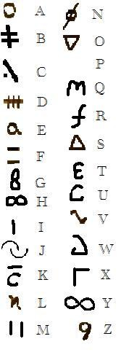
String Literals
Live Demo

Slide 103

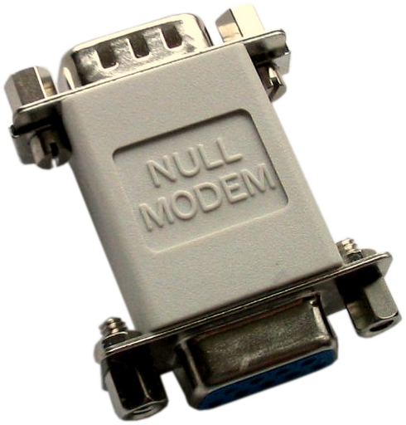

Nullable Types

Slide 104
Nullable Types
Nullable types are instances of the System.Nullable struct
Wrapper over the primitive types
E.g. int?, double?, etc.
Nullabe type can represent the normal range of values for its underlying value type, plus an additional null value
Useful when dealing with Databases or other structures that have default value null

Slide 105
Nullable Types – Example
Example with Integer:
int? someInteger = null;
Console.WriteLine(
"This is the integer with Null value -> " + someInteger);
someInteger = 5;
Console.WriteLine(
"This is the integer with value 5 -> " + someInteger);
Example with Double:
double? someDouble = null;
Console.WriteLine(
"This is the real number with Null value -> "
+ someDouble);
someDouble = 2.5;
Console.WriteLine(
"This is the real number with value 5 -> " +
someDouble);

Slide 106
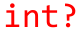
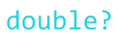
Nullable Types
Live Demo

Slide 107

Dynamic Types in C#
Types Holding Anything & Evaluated at Runtime

Slide 108
Dynamic Types
Dynamic types in C# (keyword dynamic)
Can hold anything (string, number, object, function / method reference)
Operations evaluated at runtime
Behave like types in JavaScript / PHP
dynamic a = 5;
dynamic b = 3;
Console.WriteLine(a + b); // 8 (sum of integers)
a = "5";
b = 3;
Console.WriteLine(a + b); // 53 (string concatenation)

Slide 109
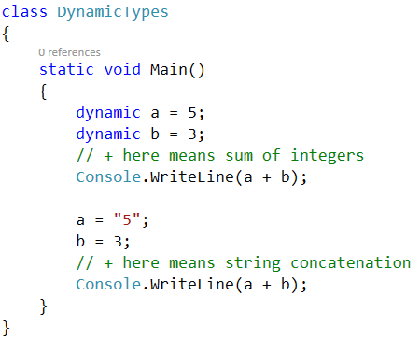
Dynamic Types
Live Demo

Slide 110

Primitive Data Types and Variables
http://academy.telerik.com

Slide 111
Free Trainings @ Telerik Academy
Fundamentals of C# Programming Track of Courses
csharpfundamentals.telerik.com
Telerik Software Academy
academy.telerik.com
Telerik Academy @ Facebook
facebook.com/TelerikAcademy
Telerik Academy Learning System
telerikacademy.com

Slide 112


Operators and Expressions
Performing Simple Calculations with C#
C# Fundamentals – Part 1
Telerik Software Academy
http://academy.telerik.com

Slide 113

Table of Contents
Operators in C# and Operator Precedence
Arithmetic Operators
Logical Operators
Bitwise Operators
Comparison Operators
Assignment Operators
Other Operators
Implicit and Explicit Type Conversions
Expressions

Slide 114


Operators in C#
Arithmetic, Logical, Comparison, Assignment, Etc.

Slide 115
What is an Operator?
Operator is an operation performed over data at runtime
Takes one or more arguments (operands)
Produces a new value
Operators have precedence
Precedence defines which will be evaluated first
Expressions are sequences of operators and operands that are evaluated to a single value

Slide 116

Operators in C#
Operators in C# :
Unary – take one operand
Binary – take two operands
Ternary (?:) – takes three operands
Except for the assignment operators, all binary operators are left-associative
The assignment operators and the conditional operator (?:) are right-associative

Slide 117
Categories of Operators in C#
Category | Operators
Arithmetic | + - * / % ++ --
Logical | && || ^ !
Binary | & | ^ ~ << >>
Comparison | == != < > <= >=
Assignment | = += -= *= /= %= &= |= ^= <<= >>=
String concatenation | +
Type conversion | is as typeof
Other | . [] () ?: new

Slide 118

Operators Precedence

Slide 119
Operators Precedence
Precedence | Operators
Highest | ()
 | ++ -- (postfix) new typeof
 | ++ -- (prefix) + - (unary) ! ~
 | * / %
 | + -
 | << >>
 | < > <= >= is as
 | == !=
 | &
Lower | ^

Slide 120
Operators Precedence (2)
Precedence | Operators
Higher | |
 | &&
 | ||
 | ?:
Lowest | = *= /= %= += -= <<= >>= &= ^= |=
Parenthesis operator always has highest precedence
Note: prefer using parentheses, even when it seems stupid to do so

Slide 121
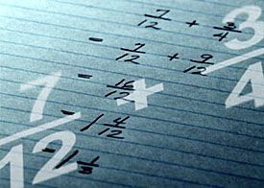
Arithmetic Operators

Slide 122
Arithmetic Operators
Arithmetic operators +, -, * are the same as in math
Division operator / if used on integers returns integer (without rounding) or exception
Division operator / if used on real numbers returns real number or Infinity or NaN
Remainder operator % returns the remainder from division of integers
The special addition operator ++ increments a variable

Slide 123
Arithmetic Operators – Example
int squarePerimeter = 17;
double squareSide = squarePerimeter / 4.0;
double squareArea = squareSide * squareSide;
Console.WriteLine(squareSide); // 4.25
Console.WriteLine(squareArea); // 18.0625
int a = 5;
int b = 4;
Console.WriteLine( a + b ); // 9
Console.WriteLine( a + b++ ); // 9
Console.WriteLine( a + b ); // 10
Console.WriteLine( a + (++b) ); // 11
Console.WriteLine( a + b ); // 11
Console.WriteLine(12 / 3); // 4
Console.WriteLine(11 / 3); // 3

Slide 124
Arithmetic Operators – Example (2)
Console.WriteLine(11.0 / 3); // 3.666666667
Console.WriteLine(11 / 3.0); // 3.666666667
Console.WriteLine(11 % 3); // 2
Console.WriteLine(11 % -3); // 2
Console.WriteLine(-11 % 3); // -2
Console.WriteLine(1.5 / 0.0); // Infinity
Console.WriteLine(-1.5 / 0.0); // -Infinity
Console.WriteLine(0.0 / 0.0); // NaN
int x = 0;
Console.WriteLine(5 / x); // DivideByZeroException

Slide 125
Arithmetic Operators – Overflow Examples
int bigNum = 2000000000;
int bigSum = 2 * bigNum; // Integer overflow!
Console.WriteLine(bigSum); // -294967296
bigNum = Int32.MaxValue;
bigNum = bigNum + 1;
Console.WriteLine(bigNum); // -2147483648
checked
{
// This will cause OverflowException
bigSum = bigNum * 2;
}

Slide 126

Arithmetic Operators
Live Demo

Slide 127

Logical Operators

Slide 128
Logical Operators
Logical operators take boolean operands and return boolean result
Operator ! turns true to false and false to true
Behavior of the operators &&, || and ^ (1 == true, 0 == false) :
Operation | || | || | || | || | && | && | && | && | ^ | ^ | ^ | ^
Operand1 | 0 | 0 | 1 | 1 | 0 | 0 | 1 | 1 | 0 | 0 | 1 | 1
Operand2 | 0 | 1 | 0 | 1 | 0 | 1 | 0 | 1 | 0 | 1 | 0 | 1
Result | 0 | 1 | 1 | 1 | 0 | 0 | 0 | 1 | 0 | 1 | 1 | 0

Slide 129
Logical Operators – Example
Using the logical operators:
bool a = true;
bool b = false;
Console.WriteLine(a && b); // False
Console.WriteLine(a || b); // True
Console.WriteLine(a ^ b); // True
Console.WriteLine(!b); // True
Console.WriteLine(b || true); // True
Console.WriteLine(b && true); // False
Console.WriteLine(a || true); // True
Console.WriteLine(a && true); // True
Console.WriteLine(!a); // False
Console.WriteLine((5>7) ^ (a==b)); // False

Slide 130


Logical Operators
Live Demo

Slide 131

Bitwise Operators

Slide 132
Bitwise Operators
Bitwise operator ~ turns all 0 to 1 and all 1 to 0
Like ! for boolean expressions but bit by bit
The operators |, & and ^ behave like ||, && and ^ for boolean expressions but bit by bit
The << and >> move the bits (left or right)
Behavior of the operators|, & and ^:
Operation | | | | | | | | | & | & | & | & | ^ | ^ | ^ | ^
Operand1 | 0 | 0 | 1 | 1 | 0 | 0 | 1 | 1 | 0 | 0 | 1 | 1
Operand2 | 0 | 1 | 0 | 1 | 0 | 1 | 0 | 1 | 0 | 1 | 0 | 1
Result | 0 | 1 | 1 | 1 | 0 | 0 | 0 | 1 | 0 | 1 | 1 | 0

Slide 133
Bitwise Operators (2)
Bitwise operators are used on integer numbers (byte, sbyte, int, uint, long, ulong)
Bitwise operators are applied bit by bit
Examples:
ushort a = 3; // 00000000 00000011
ushort b = 5; // 00000000 00000101
Console.WriteLine( a | b); // 00000000 00000111
Console.WriteLine( a & b); // 00000000 00000001
Console.WriteLine( a ^ b); // 00000000 00000110
Console.WriteLine(~a & b); // 00000000 00000100
Console.WriteLine( a << 1); // 00000000 00000110
Console.WriteLine( a >> 1); // 00000000 00000001

Slide 134

Bitwise Operators – Tips & Tricks
How to get the bit at position p in a number n?
How to set the bit at position p to 0?
int p = 5;
int n = 35; // 00000000 00100011
int mask = 1 << p; // 00000000 00100000
int nAndMask = n & mask; // 00000000 00100000
int bit = nAndMask >> p; // 00000000 00000001
Console.WriteLine(bit); // 1
int p = 5;
int n = 35; // 00000000 00100011
int mask = ~(1 << p); // 11111111 11011111
int result = n & mask; // 00000000 00000011
Console.WriteLine(result); // 3

Slide 135

Bitwise Operators – Tips & Tricks (2)
How to set the bit at position p to 1?
How to print a binary number to the console?
int p = 4;
int n = 35; // 00000000 00100011
int mask = 1 << p; // 00000000 00010000
int result = n | mask; // 00000000 00110011
Console.WriteLine(result); // 51
Console.WriteLine(
Convert.ToString(result, 2).PadLeft(32, '0'));
// 00000000000000000000000000110011

Slide 136


Bitwise Operators
Live Demo

Slide 137

Comparison and Assignment Operators

Slide 138

Comparison Operators
Comparison operators are used to compare variables
==, <, >, >=, <=, !=
Comparison operators example:
int a = 5;
int b = 4;
Console.WriteLine(a >= b); // True
Console.WriteLine(a != b); // True
Console.WriteLine(a == b); // False
Console.WriteLine(a == a); // True
Console.WriteLine(a != ++b); // False
Console.WriteLine(a > b); // False

Slide 139

Assignment Operators
Assignment operators are used to assign a value to a variable ,
=, +=, -=, |=, ...
Assignment operators example:
int x = 6;
int y = 4;
Console.WriteLine(y *= 2); // 8
int z = y = 3; // y=3 and z=3
Console.WriteLine(z); // 3
Console.WriteLine(x |= 1); // 7
Console.WriteLine(x += 3); // 10
Console.WriteLine(x /= 2); // 5

Slide 140

Comparison and Assignment Operators
Live Demo

Slide 141

Other Operators

Slide 142

Other Operators
String concatenation operator + is used to concatenate strings
If the second operand is not a string, it is converted to string automatically
string first = "First";
string second = "Second";
Console.WriteLine(first + second); // FirstSecond
string output = "The number is : ";
int number = 5;
Console.WriteLine(output + number);
// The number is : 5

Slide 143
Other Operators (2)
Member access operator . is used to access object members
Square brackets [] are used with arrays indexers and attributes
Parentheses ( ) are used to override the default operator precedence
Class cast operator (type) is used to cast one compatible type to another

Slide 144
Other Operators (3)
Conditional operator ?: has the form
(if b is true then the result is x else the result is y)
The new operator is used to create new objects
The typeof operator returns System.Type object (the reflection of a type)
The is operator checks if an object is compatible with given type
b ? x : y

Slide 145
Other Operators
Null-coalescing operator ?? is used to define a default value for both nullable value types and reference types
It returns the left-hand operand if it is not null
Otherwise it returns the right operand
Here the value of y is -1
int? x = null;
int y = x ?? -1;
int? x = 1;
int y = x ?? -1;
Here the value of y is 1

Slide 146
Other Operators – Example
Using some other operators:
int a = 6;
int b = 4;
Console.WriteLine(a > b ? "a>b" : "b>=a"); // a>b
Console.WriteLine((long) a); // 6
int c = b = 3; // b=3; followed by c=3;
Console.WriteLine(c); // 3
Console.WriteLine(a is int); // True
Console.WriteLine((a+b)/2); // 4
Console.WriteLine(typeof(int)); // System.Int32
int d = new int();
Console.WriteLine(d); // 0

Slide 147

Other Operators
Live Demo

Slide 148

Implicit and Explicit Type Conversions

Slide 149
Implicit Type Conversion
Implicit type conversion
Automatic conversion of value of one data type to value of another data type
Allowed when no loss of data is possible
"Larger" types can implicitly take values of smaller "types"
Example:
int i = 5;
long l = i;

Slide 150
Explicit Type Conversion
Explicit type conversion
Manual conversion of a value of one data type to a value of another data type
Allowed only explicitly by (type) operator
Required when there is a possibility of loss of data or precision
Example:
long l = 5;
int i = (int) l;

Slide 151
Type Conversions – Example
Example of implicit and explicit conversions:
Note: Explicit conversion may be used even if not required by the compiler
float heightInMeters = 1.74f; // Explicit conversion
double maxHeight = heightInMeters; // Implicit
double minHeight = (double) heightInMeters; // Explicit
float actualHeight = (float) maxHeight; // Explicit
float maxHeightFloat = maxHeight; // Compilation error!

Slide 152

Type Conversions
Live Demo

Slide 153

Expressions

Slide 154
Expressions
Expressions are sequences of operators, literals and variables that are evaluated to some value
Examples:
int r = (150-20) / 2 + 5; // r=70
// Expression for calculation of circle area
double surface = Math.PI * r * r;
// Expression for calculation of circle perimeter
double perimeter = 2 * Math.PI * r;

Slide 155
Expressions (2)
Expressions have:
Type (integer, real, boolean, ...)
Value
Examples:
Expression of type int. Calculated at runtime.
Expression of type int. Calculated at compile time.
int a = 2 + 3; // a = 5
int b = (a+3) * (a-4) + (2*a + 7) / 4; // b = 12
bool greater = (a > b) || ((a == 0) && (b == 0));
Expression of type bool. Calculated at runtime.

Slide 156

Expressions
Live Demo

Slide 157
Summary
We discussed the operators in C#:
Arithmetic, logical, bitwise, comparison, assignment and others
Bitwise calculations
Operator precedence
We learned when to use implicit and explicit type conversions
We learned how to use expressions

Slide 158
Resources
Boolean algebra (logic)
http://en.wikipedia.org/wiki/Boolean_algebra_%28logic%29
Bitwise mask
http://en.wikipedia.org/wiki/Mask_%28computing%29
Bitwise operation
http://en.wikipedia.org/wiki/Bitwise_operation
Bit Twiddling Hacks
graphics.stanford.edu/~seander/bithacks.html

Slide 159

Operators and Expressions
http://academy.telerik.com

Slide 160
Free Trainings @ Telerik Academy
Fundamentals of C# Programming Track of Courses
csharpfundamentals.telerik.com
Telerik Software Academy
academy.telerik.com
Telerik Academy @ Facebook
facebook.com/TelerikAcademy
Telerik Academy Learning System
telerikacademy.com

Slide 161


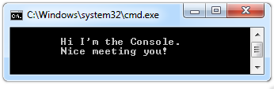



Console Input / Output
Reading and Writing to the Console
C# Fundamentals – Part 1
Telerik Software Academy
http://academy.telerik.com

Slide 162

Table of Contents
Printing to the Console
Printing Strings and Numbers
Reading from the Console
Reading Characters
Reading Strings
Parsing Strings to Numeral Types
Reading Numeral Types
Various Examples

Slide 163
Printing to the Console
Printing Strings, Numeral Types and Expressions

Slide 164

Printing to the Console
Console is used to display information in a text window
Can display different values:
Strings
Numeral types
All primitive data types
To print to the console use the class Console (System.Console)

Slide 165
The Console Class
Provides methods for console input and output
Input
Read(…) – reads a single character
ReadKey(…) – reads a combination of keys
ReadLine(…) – reads a single line of characters
Output
Write(…) – prints the specified argument on the console
WriteLine(…) – prints specified data to the console and moves to the next line

Slide 166
Console.Write(…)
Printing an integer variable
int a = 15;
...
Console.Write(a); // 15
Printing more than one variable using a formatting string
double a = 15.5;
int b = 14;
...
Console.Write("{0} + {1} = {2}", a, b, a + b);
// 15.5 + 14 = 29.5
Next print operation will start from the same line

Slide 167
Console.WriteLine(…)
Printing a string variable
string str = "Hello C#!";
...
Console.WriteLine(str);
Printing more than one variable using a formatting string
string name = "Marry";
int year = 1987;
...
Console.WriteLine("{0} was born in {1}.", name, year);
// Marry was born in 1987.
Next printing will start from the new line

Slide 168
Printing to the Console – Example
static void Main()
{
string name = "Peter";
int age = 18;
string town = "Sofia";
Console.Write("{0} is {1} years old from {2}.",
name, age, town);
// Result: Peter is 18 years old from Sofia.
Console.Write("This is on the same line!");
Console.WriteLine("Next sentence will be" +
" on a new line.");
Console.WriteLine("Bye, bye, {0} from {1}.",
name, town);
}

Slide 169
Formatting Strings
{index[,alignment][:formatString]}
index
The zero-based index of the argument whose string representation is to be included at this position in the string
alignment
A signed integer that indicates the total length of the field into which the argument is inserted
a positive integer – right-aligned
a negative integer – left-aligned

Slide 170
Formatting Strings
{index[,alignment][:formatString]}
formatString
Specifies the format of the corresponding argument's result string, e.g. "X", "C", "0.00"
Example:
static void Main()
{
double pi = 1.234;
Console.WriteLine("{0:0.000000}", pi);
// 1.234000
}

Slide 171
Formatting Strings – Example
static void Main()
{
int a=2, b=3;
Console.Write("{0} + {1} =", a, b);
Console.WriteLine(" {0}", a+b);
// 2 + 3 = 5
Console.WriteLine("{0} * {1} = {2}",
a, b, a*b);
// 2 * 3 = 6
float pi = 3.14159206;
Console.WriteLine("{0:F2}", pi); // 3,14
Console.WriteLine("Bye – Bye!");
}

Slide 172
Printing a Menu – Example
double colaPrice = 1.20;
string cola = "Coca Cola";
double fantaPrice = 1.20;
string fanta = "Fanta Dizzy";
double zagorkaPrice = 1.50;
string zagorka = "Zagorka";
Console.WriteLine("Menu:");
Console.WriteLine("1. {0} – {1}",
cola, colaPrice);
Console.WriteLine("2. {0} – {1}",
fanta, fantaPrice);
Console.WriteLine("3. {0} – {1}",
zagorka, zagorkaPrice);
Console.WriteLine("Have a nice day!");

Slide 173

Printing to the Console
Live Demo

Slide 174

Reading from the Console
Reading Strings and Numeral Types

Slide 175
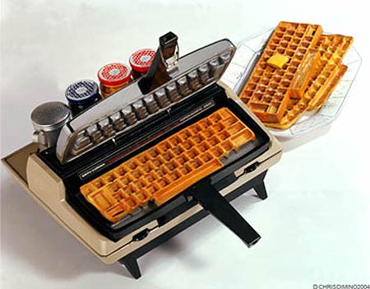
Reading from the Console
We use the console to read information from the command line
We can read:
Characters
Strings
Numeral types (after conversion)
To read from the console we use the methods Console.Read() and Console.ReadLine()

Slide 176
Console.Read()
Gets a single character from the console (after [Enter] is pressed)
Returns a result of type int
Returns -1 if there aren’t more symbols
To get the actually read character we need to cast it to char
int i = Console.Read();
char ch = (char) i; // Cast the int to char
// Gets the code of the entered symbol
Console.WriteLine("The code of '{0}' is {1}.", ch, i);

Slide 177


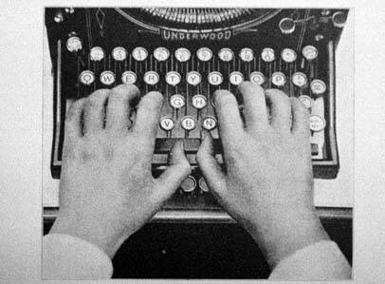
Reading Characters from the Console
Live Demo

Slide 178
Console.ReadKey()
Waits until a combination of keys is pressed
Reads a single character from console or a combination of keys
Returns a result of type ConsoleKeyInfo
KeyChar – holds the entered character
Modifiers – holds the state of [Ctrl], [Alt], …
ConsoleKeyInfo key = Console.ReadKey();
Console.WriteLine();
Console.WriteLine("Character entered: " + key.KeyChar);
Console.WriteLine("Special keys: " + key.Modifiers);

Slide 179
Reading Keys from the Console
Live Demo

Slide 180
Console.ReadLine()
Gets a line of characters
Returns a string value
Returns null if the end of the input is reached
Console.Write("Please enter your first name: ");
string firstName = Console.ReadLine();
Console.Write("Please enter your last name: ");
string lastName = Console.ReadLine();
Console.WriteLine("Hello, {0} {1}!",
firstName, lastName);

Slide 181

Reading Strings from the Console
Live Demo

Slide 182
Reading Numeral Types
Numeral types can not be read directly from the console
To read a numeral type do the following:
Read a string value
Convert (parse) it to the required numeral type
int.Parse(string)
Parses (converts) a string to int
string str = Console.ReadLine()
int number = int.Parse(str);
Console.WriteLine("You entered: {0}", number);

Slide 183
Converting Strings to Numbers
Numeral types have a method Parse(…) for extracting the numeral value from a string
int.Parse(string) – string → int
long.Parse(string) – string → long
float.Parse(string) – string → float
Causes FormatException in case of error
string s = "123";
int i = int.Parse(s); // i = 123
long l = long.Parse(s); // l = 123L
string invalid = "xxx1845";
int value = int.Parse(invalid); // FormatException

Slide 184
Reading Numbers from the Console – Example
static void Main()
{
int a = int.Parse(Console.ReadLine());
int b = int.Parse(Console.ReadLine());
Console.WriteLine("{0} + {1} = {2}",
a, b, a+b);
Console.WriteLine("{0} * {1} = {2}",
a, b, a*b);
float f = float.Parse(Console.ReadLine());
Console.WriteLine("{0} * {1} / {2} = {3}",
a, b, f, a*b/f);
}

Slide 185
Converting Strings to Numbers (2)
Converting can also be done using the methods of the Convert class
Convert.ToInt32(string) – string → int
Convert.ToSingle(string)– string → float
Convert.ToInt64(string)– string → long
It uses the parse methods of the numeral types
string s = "123";
int i = Convert.ToInt32(s); // i = 123
long l = Convert.ToInt64(s); // l = 123L
string invalid = "xxx1845";
int value = Convert.ToInt32(invalid); // FormatException

Slide 186
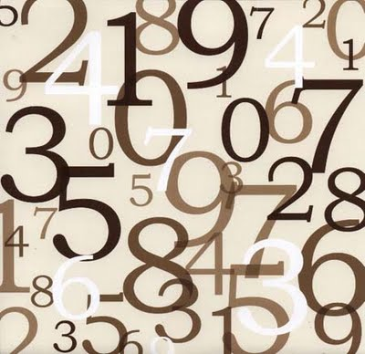
Reading Numbers from the Console
Live Demo

Slide 187
Error Handling when Parsing
Sometimes we want to handle the errors when parsing a number
Two options: use try-catch block or TryParse()
Parsing with TryParse():
string str = Console.ReadLine();
int number;
if (int.TryParse(str, out number))
{
Console.WriteLine("Valid number: {0}", number);
}
else
{
Console.WriteLine("Invalid number: {0}", str);
}

Slide 188
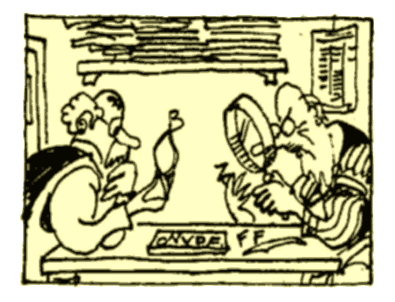
Parsing with TryParse()
Live Demo

Slide 189



Regional Settings
Printing and Reading Special Characters
Regional Settings and the Number Formatting

Slide 190
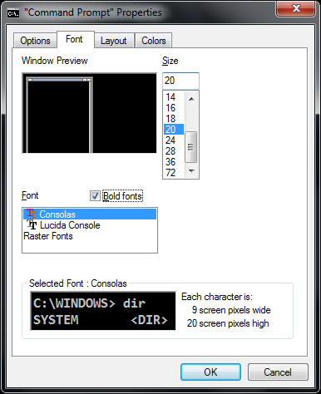
How to Print Special Characters on the Console?
Printing special characters on the console needs two steps:
Change the console properties to enable Unicode-friendly font
Enable Unicode for the Console by adjusting its output encoding
Prefer UTF8 (Unicode)
using System.Text;
…
Console.OutputEncoding = Encoding.UTF8;
Console.WriteLine("Това е кирилица: ☺");

Slide 191
Decimal Separator
The currency format and number formats are different in different countries
E.g. the decimal separator could be "." or ","
To ensure the decimal separator is "." use the following code:
using System.Threading;
using System.Globalization;
…
Thread.CurrentThread.CurrentCulture =
CultureInfo.InvariantCulture;
Console.WriteLine(3.54); // 3.54
decimal value = decimal.Parse("1.33");

Slide 192

Regional Settings
Live Demo

Slide 193


Reading and Printing to the Console
Various Examples
Examples

Slide 194
Printing a Letter – Example
Console.Write("Enter person name: ");
string person = Console.ReadLine();
Console.Write("Enter company name: ");
string company = Console.ReadLine();
Console.WriteLine(" Dear {0},", person);
Console.WriteLine("We are pleased to tell you " +
"that {1} has chosen you to take part " +
"in the \"Introduction To Programming\" " +
"course. {1} wishes you good luck!",
person, company);
Console.WriteLine(" Yours,");
Console.WriteLine(" {0}", company);

Slide 195

Printing a Letter
Live Demo

Slide 196
Calculating Area – Example
Console.WriteLine("This program calculates " +
"the area of a rectangle or a triangle");
Console.Write("Enter a and b (for rectangle) " +
" or a and h (for triangle): ");
int a = int.Parse(Console.ReadLine());
int b = int.Parse(Console.ReadLine());
Console.Write("Enter 1 for a rectangle or 2 " +
"for a triangle: ");
int choice = int.Parse(Console.ReadLine());
double area = (double) (a*b) / choice;
Console.WriteLine("The area of your figure " +
" is {0}", area);

Slide 197

Calculating Area
Live Demo

Slide 198
Summary
We have discussed the basic input and output methods of the class Console
Write(…) and WriteLine(…)
Used to write values to the console
Read(…) and ReadLine(…)
Used to read values from the console
Parsing numbers to strings
int.Parse(…), double.Parse(…), …

Slide 199
Console Input / Output
http://academy.telerik.com

Slide 200
Free Trainings @ Telerik Academy
Fundamentals of C# Programming Track of Courses
csharpfundamentals.telerik.com
Telerik Software Academy
academy.telerik.com
Telerik Academy @ Facebook
facebook.com/TelerikAcademy
Telerik Academy Learning System
telerikacademy.com

Slide 201
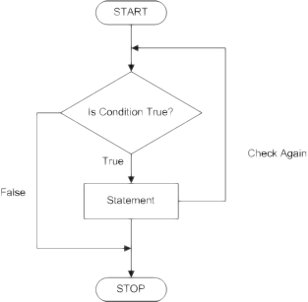
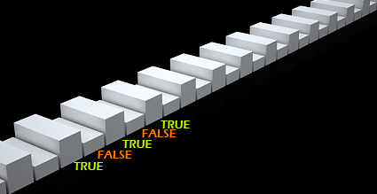
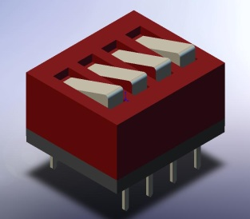
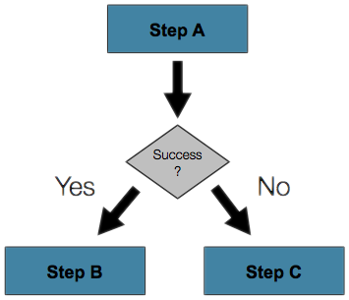

Conditional Statements
Implementing Control Logic in C#
C# Fundamentals – Part 1
Telerik Software Academy
http://academy.telerik.com

Slide 202


Table of Contents
Comparison and Logical Operators
The if Statement
The if-else Statement
Nested if Statements
The switch-case Statement

Slide 203

Comparison and Logical Operators

Slide 204
Comparison Operators
Operator | Notation in C#
Equals | ==
Not Equals | !=
Greater Than | >
Greater Than or Equals | >=
Less Than | <
Less Than or Equals | <=
Example:
bool result = 5 <= 6;
Console.WriteLine(result); // True

Slide 205

Logical Operators
Operator | Notation in C#
Logical NOT | !
Logical AND | &&
Logical OR | ||
Logical Exclusive OR (XOR) | ^
De Morgan laws
!!A ⬄ A
!(A || B) ⬄ !A && !B
!(A && B) ⬄ !A || !B

Slide 206

if and if-else
Implementing Conditional Logic

Slide 207
The if Statement
The most simple conditional statement
Enables you to test for a condition
Branch to different parts of the code depending on the result
The simplest form of an if statement:
if (condition)
{
statements;
}

Slide 208

Condition and Statement
The condition can be:
Boolean variable
Boolean logical expression
Comparison expression
The condition cannot be integer variable (like in C / C++ or JavaScript)
The statement can be:
Single statement ending with a semicolon
Block enclosed in braces

Slide 209
How It Works?
condition
false
true
statement
The condition is evaluated
If it is true, the statement is executed
If it is false, the statement is skipped

Slide 210
The if Statement – Example
static void Main()
{
Console.WriteLine("Enter two numbers.");
int biggerNumber = int.Parse(Console.ReadLine());
int smallerNumber = int.Parse(Console.ReadLine());
if (smallerNumber > biggerNumber)
{
biggerNumber = smallerNumber;
}
Console.WriteLine("The greater number is: {0}",
biggerNumber);
}

Slide 211

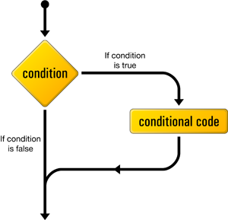

The if Statement
Live Demo

Slide 212
The if-else Statement
More complex and useful conditional statement
Executes one branch if the condition is true, and another if it is false
The simplest form of an if-else statement:
if (expression)
{
statement1;
}
else
{
statement2;
}

Slide 213
How It Works ?
condition
false
second
statement
true
first
statement
The condition is evaluated
If it is true, the first statement is executed
If it is false, the second statement is executed

Slide 214
if-else Statement – Example
Checking a number if it is odd or even
string s = Console.ReadLine();
int number = int.Parse(s);
if (number % 2 == 0)
{
Console.WriteLine("This number is even.");
}
else
{
Console.WriteLine("This number is odd.");
}

Slide 215
The if-else Statement
Live Demo

Slide 216
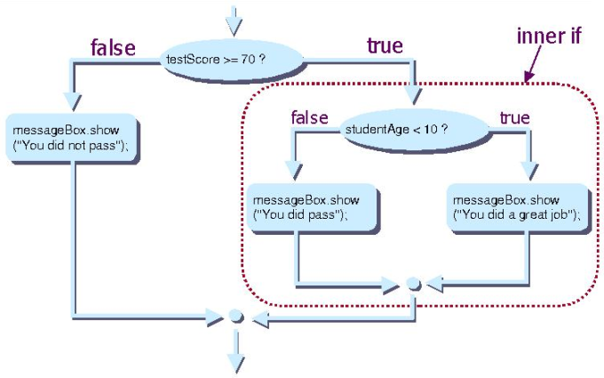
Nested if Statements
Creating More Complex Logic

Slide 217
Nested if Statements
if and if-else statements can be nested, i.e. used inside another if or else statement
Every else corresponds to its closest preceding if
if (expression)
{
if (expression)
{
statement;
}
else
{
statement;
}
}
else
statement;

Slide 218
Nested if – Good Practices
Always use { … } blocks to avoid ambiguity
Even when a single statement follows
Avoid using more than three levels of nested if statements
Put the case you normally expect to process first, then write the unusual cases
Arrange the code to make it more readable

Slide 219
Nested if Statements – Example
if (first == second)
{
Console.WriteLine(
"These two numbers are equal.");
}
else
{
if (first > second)
{
Console.WriteLine(
"The first number is bigger.");
}
else
{
Console.WriteLine("The second is bigger.");
}
}

Slide 220
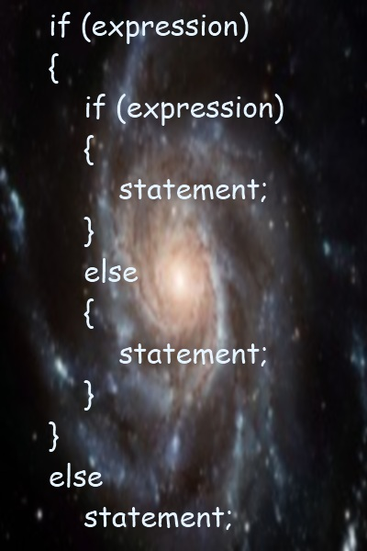
Nested if Statements
Live Demo

Slide 221
Multiple if-else-if-else-…
Sometimes we need to use another if-construction in the else block
Thus else if can be used:
int ch = 'X';
if (ch == 'A' || ch == 'a')
{
Console.WriteLine("Vowel [ei]");
}
else if (ch == 'E' || ch == 'e')
{
Console.WriteLine("Vowel [i:]");
}
else if …
else …

Slide 222
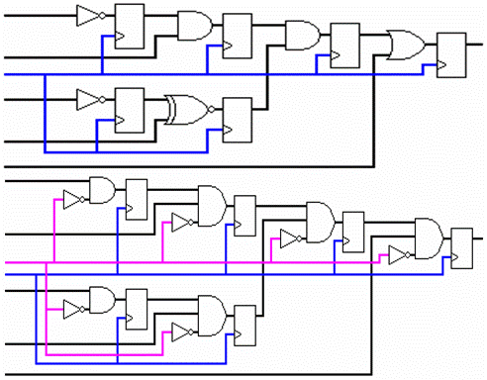
Multiple if-else Statements
Live Demo

Slide 223

switch-case
Making Several Comparisons at Once

Slide 224
The switch-case Statement
Selects for execution a statement from a list depending on the value of the switch expression
switch (day)
{
case 1: Console.WriteLine("Monday"); break;
case 2: Console.WriteLine("Tuesday"); break;
case 3: Console.WriteLine("Wednesday"); break;
case 4: Console.WriteLine("Thursday"); break;
case 5: Console.WriteLine("Friday"); break;
case 6: Console.WriteLine("Saturday"); break;
case 7: Console.WriteLine("Sunday"); break;
default: Console.WriteLine("Error!"); break;
}

Slide 225
How switch-case Works?
The expression is evaluated
When one of the constants specified in a case label is equal to the expression
The statement that corresponds to that case is executed
If no case is equal to the expression
If there is default case, it is executed
Otherwise the control is transferred to the end point of the switch statement

Slide 226

The switch-case Statement
Live Demo

Slide 227
Using switch: Rules
Variables types like string, enum and integral types can be used for switch expression
The value null is permitted as a case label constant
The keyword break exits the switch statement
"No fall through" rule – you are obligated to use break after each case
Multiple labels that correspond to the same statement are permitted

Slide 228
Multiple Labels – Example
You can use multiple labels to execute the same statement in more than one case
switch (animal)
{
case "dog" :
Console.WriteLine("MAMMAL");
break;
case "crocodile" :
case "tortoise" :
case "snake" :
Console.WriteLine("REPTILE");
break;
default :
Console.WriteLine("There is no such animal!");
break;
}

Slide 229

Multiple Labels in a switch-case
Live Demo

Slide 230
Using switch – Good Practices
There must be a separate case for every normal situation
Put the normal case first
Put the most frequently executed cases first and the least frequently executed last
Order cases alphabetically or numerically
In default use case that cannot be reached under normal circumstances

Slide 231
Summary
Comparison and logical operators are used to compose logical conditions
The conditional statements if and if-else provide conditional execution of blocks of code
Constantly used in computer programming
Conditional statements can be nested
The switch statement easily and elegantly checks an expression for a sequence of values

Slide 232
Conditional Statements
http://academy.telerik.com

Slide 233
Free Trainings @ Telerik Academy
Fundamentals of C# Programming Track of Courses
csharpfundamentals.telerik.com
Telerik Software Academy
academy.telerik.com
Telerik Academy @ Facebook
facebook.com/TelerikAcademy
Telerik Academy Learning System
telerikacademy.com

Slide 234


Loops
Execute Blocks of Code Multiple Times
C# Fundamentals – Part 1
Telerik Software Academy
http://academy.telerik.com

Slide 235

Table of Contents
What is a Loop?
Loops in C#
while loops
do … while loops
for loops
foreach loops
Special loop operators
break, continue, goto
Nested loops

Slide 236
What Is Loop?
A loop is a control statement that allows repeating execution of a block of statements
May execute a code block fixed number of times
May execute a code block while given condition holds
May execute a code block for each member of a collection
Loops that never end are called an infinite loops

Slide 237

Using while(…) Loop
Repeating a Statement While Given Condition Holds

Slide 238
How To Use While Loop?
The simplest and most frequently used loop
The repeat condition
Returns a boolean result of true or false
Also called loop condition
while (condition)
{
statements;
}

Slide 239
While Loop – How It Works?
condition
false
true
statement

Slide 240
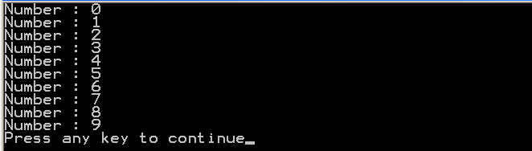
While Loop – Example
int counter = 0;
while (counter < 10)
{
Console.WriteLine("Number : {0}", counter);
counter++;
}

Slide 241

while(…)
Examples

Slide 242
Sum 1..N – Example
Calculate and print the sum of the first N natural numbers
Console.Write("n = ");
int n = int.Parse(Console.ReadLine());
int number = 1;
int sum = 1;
Console.Write("The sum 1");
while (number < n)
{
number++;
sum += number ;
Console.Write("+{0}", number);
}
Console.WriteLine(" = {0}", sum);

Slide 243

Calculating Sum 1..N
Live Demo

Slide 244
Prime Number – Example
Checking whether a number is prime or not
Console.Write("Enter a positive integer number: ");
string consoleArgument=Console.ReadLine();
uint number = uint.Parse(consoleArgument);
uint divider = 2;
uint maxDivider = (uint) Math.Sqrt(number);
bool prime = true;
while (prime && (divider <= maxDivider))
{
if (number % divider == 0)
{
prime = false;
}
divider++;
}
Console.WriteLine("Prime? {0}", prime);

Slide 245
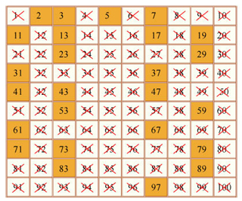
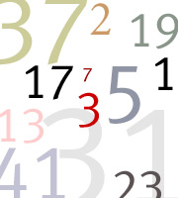
Checking Whether a Number Is Prime
Live Demo

Slide 246
Using break Operator
break operator exits the inner-most loop
static void Main()
{
int n = Convert.ToInt32(Console.ReadLine());
// Calculate n! = 1 * 2 * ... * n
int result = 1;
while (true)
{
if (n == 1)
break;
result *= n;
n--;
}
Console.WriteLine("n! = " + result);
}

Slide 247
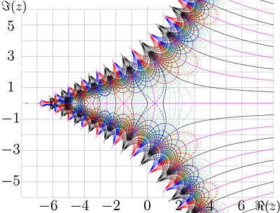
Calculating Factorial
Live Demo

Slide 248

do { … } while (…) Loop

Slide 249

Using Do-While Loop
Another loop structure is:
The block of statements is repeated
While the boolean loop condition holds
The loop is executed at least once
do
{
statements;
}
while (condition);

Slide 250
Do-While Statement
statement
true
condition
false

Slide 251

do { … } while (…)
Examples

Slide 252
Factorial – Example
Calculating N factorial
static void Main()
{
string numberAsString = Console.ReadLine();
int n = Convert.ToInt32(numberAsString);
int factorial = 1;
do
{
factorial *= n;
n--;
}
while (n > 0);
Console.WriteLine("n! = " + factorial);
}

Slide 253
Factorial with BigInteger – Example
Calculating N factorial with BigInteger
Don't forget to add reference to System.Numerics.dll.
using System.Numerics;
static void Main()
{
int n = 1000;
BigInteger factorial = 1;
do
{
factorial *= n;
n--;
}
while (n > 0);
Console.WriteLine("n! = " + factorial);
}

Slide 254

Factorial (do ... while)
Live Demo

Slide 255
Product[N..M] – Example
Calculating the product of all numbers in the interval [n..m]:
int n = int.Parse(Console.ReadLine());
int m = int.Parse(Console.ReadLine());
int number = n;
decimal product = 1;
do
{
product *= number;
number++;
}
while (number <= m);
Console.WriteLine("product[n..m] = " + product);

Slide 256
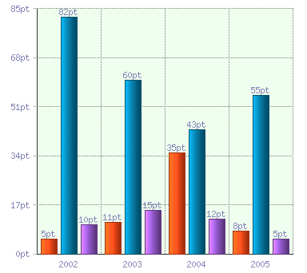
Product of the Numbers in the Interval [n..m]
Live Demo

Slide 257

for Loops

Slide 258
For Loops
The typical for loop syntax is:
Consists of
Initialization statement
Boolean test expression
Update statement
Loop body block
for (initialization; test; update) { statements; }

Slide 259
The Initialization Expression
for (int number = 0; ...; ...) { // Can use number here } // Cannot use number here
Executed once, just before the loop is entered
Like it is out of the loop, before it
Usually used to declare a counter variable

Slide 260
The Test Expression
for (int number = 0; number < 10; ...) { // Can use number here } // Cannot use number here
Evaluated before each iteration of the loop
If true, the loop body is executed
If false, the loop body is skipped
Used as a loop condition

Slide 261
The Update Expression
for (int number = 0; number < 10; number++) { // Can use number here } // Cannot use number here
Executed at each iteration after the body of the loop is finished
Usually used to update the counter

Slide 262

for Loop
Examples

Slide 263
Simple for Loop – Example
A simple for-loop to print the numbers 0…9:
for (int number = 0; number < 10; number++)
{
Console.Write(number + " ");
}
A simple for-loop to calculate n!:
decimal factorial = 1;
for (int i = 1; i <= n; i++)
{
factorial *= i;
}

Slide 264
Complex for Loop – Example
Complex for-loops could have several counter variables:
for (int i=1, sum=1; i<=128; i=i*2, sum+=i)
{
Console.WriteLine("i={0}, sum={1}", i, sum);
}
Result:
i=1, sum=1
i=2, sum=3
i=4, sum=7
i=8, sum=15
...

Slide 265

For Loops
Live Demo

Slide 266
N^M – Example
Calculating n to power m (denoted as n^m):
static void Main()
{
int n = int.Parse(Console.ReadLine());
int m = int.Parse(Console.ReadLine());
decimal result = 1;
for (int i=0; i<m; i++)
{
result *= n;
}
Console.WriteLine("n^m = " + result);
}

Slide 267

Calculating N^M
Live Demo

Slide 268
Using continue Operator
continue operator ends the iteration of the inner-most loop
Example: sum all odd numbers in [1, n] that are not divisors of 7:
int n = int.Parse(Console.ReadLine());
int sum = 0;
for (int i = 1; i <= n; i += 2)
{
if (i % 7 == 0)
{
continue;
}
sum += i;
}
Console.WriteLine("sum = {0}", sum);

Slide 269

Using continue Operator
Live Demo

Slide 270

foreach Loop
Iteration over a Collection

Slide 271
For Loops
The typical foreach loop syntax is:
Iterates over all elements of a collection
The element is the loop variable that takes sequentially all collection values
The collection can be list, array or other group of elements of the same type
foreach (Type element in collection) { statements; }

Slide 272
foreach Loop – Example
Example of foreach loop:
string[] days = {
"Monday", "Tuesday", "Wednesday", "Thursday",
"Friday", "Saturday", "Sunday" };
foreach (string day in days)
{
Console.WriteLine(day);
}
The above loop iterates of the array of days
The variable day takes all its values
In the foreach loop we cannot set the value of the current item

Slide 273

foreach Loop
Live Demo

Slide 274

Nested Loops
Using Loops Inside a Loop

Slide 275
What Is Nested Loop?
A composition of loops is called a nested loop
A loop inside another loop
Example:
for (initialization; test; update)
{
for (initialization; test; update)
{
statements;
}
…
}

Slide 276

Nested Loops
Examples

Slide 277
Triangle – Example
Print the following triangle:
1
1 2
…
1 2 3 ... n
int n = int.Parse(Console.ReadLine());
for(int row = 1; row <= n; row++)
{
for(int column = 1; column <= row; column++)
{
Console.Write("{0} ", column);
}
Console.WriteLine();
}

Slide 278

Triangle
Live Demo

Slide 279
Primes[N, M] – Example
Print all prime numbers in the interval [n, m]:
int n = int.Parse(Console.ReadLine());
int m = int.Parse(Console.ReadLine());
for (int number = n; number <= m; number++)
{
bool prime = true;
int divider = 2;
int maxDivider = Math.Sqrt(num);
while (divider <= maxDivider)
{
if (number % divider == 0)
{
prime = false;
break;
}
divider++;
}
if (prime)
{
Console.Write("{0} ", number);
}
}

Slide 280

Primes in Range [n, m]
Live Demo

Slide 281
C# Jump Statements
Jump statements are:
break, continue, goto
How continue works?
In while and do-while loops jumps to the test expression
In for loops jumps to the update expression
To exit an inner loop use break
To exit outer loops use goto with a label
Avoid using goto! (it is considered harmful)

Slide 282
C# Jump Statements – Example
int outerCounter = 0;
for (int outer = 0; outer < 10; outer++)
{ for (int inner = 0; inner < 10; inner++)
{ if (inner % 3 == 0)
continue; if (outer == 7)
break; if (inner + outer > 9)
goto breakOut; }
outerCounter++;
} breakOut:
Label

Slide 283

Loops – More Examples

Slide 284
Nested Loops – Examples
Print all four digit numbers in format ABCD such that A+B = C+D (known as happy numbers)
Can you improve this algorithm to use 3 loops only?
static void Main()
{
for (int a =1 ; a <= 9; a++)
for (int b = 0; b <= 9; b++)
for (int c = 0; c <= 9; c++)
for (int d = 0; d <= 9; d++)
if (a + b == c + d)
Console.WriteLine("{0}{1}{2}{3}",
a, b, c, d);
}

Slide 285

Happy Numbers
Live Demo

Slide 286
Nested Loops – Examples
Print all combinations from TOTO 6/49
Warning: execution of this code could take too long time.
static void Main()
{
int i1, i2, i3, i4, i5, i6;
for (i1 = 1; i1 <= 44; i1++)
for (i2 = i1 + 1; i2 <= 45; i2++)
for (i3 = i2 + 1; i3 <= 46; i3++)
for (i4 = i3 + 1; i4 <= 47; i4++)
for (i5 = i4 + 1; i5 <= 48; i5++)
for (i6 = i5 + 1; i6 <= 49; i6++)
Console.WriteLine("{0} {1} {2} {3} {4} {5}",
i1, i2, i3, i4, i5, i6);
}

Slide 287

TOTO 6/49
Live Demo

Slide 288
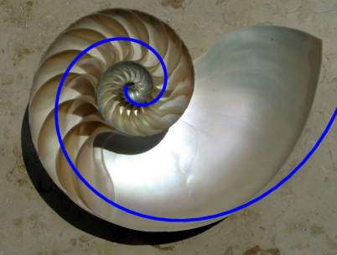
Summary
C# supports four types of loops:
while
do-while
for loops
foreach loops
Nested loops can be used to implement more complex logic
The operators continue, break & goto can control the loop execution

Slide 289
Loops
http://academy.telerik.com

Slide 290
Free Trainings @ Telerik Academy
Fundamentals of C# Programming Track of Courses
csharpfundamentals.telerik.com
Telerik Software Academy
academy.telerik.com
Telerik Academy @ Facebook
facebook.com/TelerikAcademy
Telerik Academy Learning System
telerikacademy.com

